Slide 1

Framework for Improving Cybersecurity of Critical Infrastructures
cyberframework@nist.gov

Slide 2

Improving Cybersecurity of Critical Infrastructures
“It is the policy of the United States to enhance the security and resilience of the Nation’s critical infrastructure and to maintain a cyber environment that encourages efficiency, innovation, and economic prosperity while promoting safety, security, business confidentiality, privacy, and civil liberties”
Executive Order 13636
February 12, 2013

Slide 3
The Cybersecurity Framework...
Includes a set of standards, methodologies, procedures, and processes that align policy, business, and technological approaches to address cyber risks.
Provides a prioritized, flexible, repeatable, performance-based, and cost-effective approach, including information security measures and controls, to help owners and operators of critical infrastructure to identify, assess, and manage cyber risk.
Identifies areas for improvement to be addressed through future collaboration with particular sectors and standards-developing organizations.
Is consistent with voluntary international standards.

Slide 4
Development of the Framework
Engage Stakeholders
Analyze RFI Responses
Identify Framework Elements
Collect, Categorize, Post RFI Responses
Prepare and Publish Framework
EO 13636 Issued – Feb 12, 2013
RFI Issued – Feb 2013
1st Workshop – April 2013
Completed – April 2013
2nd Workshop – May 2013
Draft Outline of Framework – June 2013
3rd Workshop – July 2013
4th Workshop – Sept 2013
Ongoing Engagement:
Open public comment/ review encouraged throughout the process…
and to this day
5th Workshop – Nov 2013
Published – Feb 12, 2014

Slide 5







The Framework Is for Organizations…
Of any size, in any sector in (and outside of) the critical infrastructure.
That already have a mature cyber risk management and cybersecurity program.
That don’t yet have a cyber risk management or cybersecurity program.
Needing to keep up-to-date managing risks, facing business or societal threats.
In the federal government, too…since it is compatible with FISMA requirements and goals.

Slide 6

Continued Improvement of Critical Infrastructure Cybersecurity
Amends the National Institute of Standards and Technology Act (15 U.S.C. 272(c)) to say:
“…on an ongoing basis, facilitate and support the development of a voluntary, consensus-based, industry-led set of standards, guidelines, best practices, methodologies, procedures, and processes to cost-effectively reduce cyber risks to critical infrastructure”
Cybersecurity Enhancement Act of 2014
(P.L. 113-274)
18 December 2014

Slide 7
Cybersecurity Framework Components
Aligns industry standards and best practices to the Framework Core in a particular implementation scenario
Supports prioritization and measurement while factoring in business needs
Cybersecurity activities and informative references, organized around particular outcomes
Enables communication of cyber risk across an organization
Framework Core
Framework Implementation Tiers
Framework Profile
Describes how cybersecurity risk is managed by an organization and degree the risk management practices exhibit key characteristics

Slide 8
Key Properties of Cyber Risk Management
Risk Management Process
Integrated Risk Management Program
External
Participation

Slide 9

Implementation Tiers
 | 1 | 2 | 3 | 4
 | Partial | Risk Informed | Repeatable | Adaptive
Risk Management Process | The functionality and repeatability of cybersecurity risk management
Integrated Risk Management Program | The extent to which cybersecurity is considered in broader risk management decisions
External Participation | The degree to which the organization benefits my sharing or receiving information from outside parties
9

Slide 10
Core Cybersecurity Framework Component
Senior Executives
Broad enterprise considerations
Abstracted risk vocabulary
Implementation/ Operations
Deep technical considerations
Highly specialized vocabulary
Specialists in Other Fields
Specific focus outside of cybersecurity
Specialized or no risk vocabulary

Slide 11
Core Cybersecurity Framework Component
 | Function | Category | ID
What processes and assets need protection? | Identify | Asset Management | ID.AM
 |  | Business Environment | ID.BE
 |  | Governance | ID.GV
 |  | Risk Assessment | ID.RA
 |  | Risk Management Strategy | ID.RM
What safeguards are available? | Protect | Access Control | PR.AC
 |  | Awareness and Training | PR.AT
 |  | Data Security | PR.DS
 |  | Information Protection Processes & Procedures | PR.IP
 |  | Maintenance | PR.MA
 |  | Protective Technology | PR.PT
What techniques can identify incidents? | Detect | Anomalies and Events | DE.AE
 |  | Security Continuous Monitoring | DE.CM
 |  | Detection Processes | DE.DP
What techniques can contain impacts of incidents? | Respond | Response Planning | RS.RP
 |  | Communications | RS.CO
 |  | Analysis | RS.AN
 |  | Mitigation | RS.MI
 |  | Improvements | RS.IM
What techniques can restore capabilities? | Recover | Recovery Planning | RC.RP
 |  | Improvements | RC.IM
 |  | Communications | RC.CO

Slide 12
Core Cybersecurity Framework Component
Subcategory | Informative References
ID.BE-1: The organization’s role in the supply chain is identified and communicated | COBIT 5 APO08.04, APO08.05, APO10.03, APO10.04, APO10.05 ISO/IEC 27001:2013 A.15.1.3, A.15.2.1, A.15.2.2 NIST SP 800-53 Rev. 4 CP-2, SA-12
ID.BE-2: The organization’s place in critical infrastructure and its industry sector is identified and communicated | COBIT 5 APO02.06, APO03.01 NIST SP 800-53 Rev. 4 PM-8
ID.BE-3: Priorities for organizational mission, objectives, and activities are established and communicated | COBIT 5 APO02.01, APO02.06, APO03.01 ISA 62443-2-1:2009 4.2.2.1, 4.2.3.6 NIST SP 800-53 Rev. 4 PM-11, SA-14
ID.BE-4: Dependencies and critical functions for delivery of critical services are established | ISO/IEC 27001:2013 A.11.2.2, A.11.2.3, A.12.1.3 NIST SP 800-53 Rev. 4 CP-8, PE-9, PE-11, PM-8, SA-14
ID.BE-5: Resilience requirements to support delivery of critical services are established | COBIT 5 DSS04.02 ISO/IEC 27001:2013 A.11.1.4, A.17.1.1, A.17.1.2, A.17.2.1 NIST SP 800-53 Rev. 4 CP-2, CP-11, SA-14
Function | Category | ID
Identify | Asset Management | ID.AM
 | Business Environment | ID.BE
 | Governance | ID.GV
 | Risk Assessment | ID.RA
 | Risk Management Strategy | ID.RM
Protect | Access Control | PR.AC
 | Awareness and Training | PR.AT
 | Data Security | PR.DS
 | Information Protection Processes & Procedures | PR.IP
 | Maintenance | PR.MA
 | Protective Technology | PR.PT
Detect | Anomalies and Events | DE.AE
 | Security Continuous Monitoring | DE.CM
 | Detection Processes | DE.DP
Respond | Response Planning | RS.RP
 | Communications | RS.CO
 | Analysis | RS.AN
 | Mitigation | RS.MI
 | Improvements | RS.IM
Recover | Recovery Planning | RC.RP
 | Improvements | RC.IM
 | Communications | RC.CO
12

Slide 13
Profile Cybersecurity Framework Component
Ways to think about a Profile:
A customization of the Core for a given sector, subsector, or organization.
A fusion of business/mission logic and cybersecurity outcomes.
Identify
Protect
Detect
Respond
Recover
An alignment of cybersecurity requirements with operational methodologies.
A basis for assessment and expressing target state.
A decision support tool for cybersecurity risk management.

Slide 14
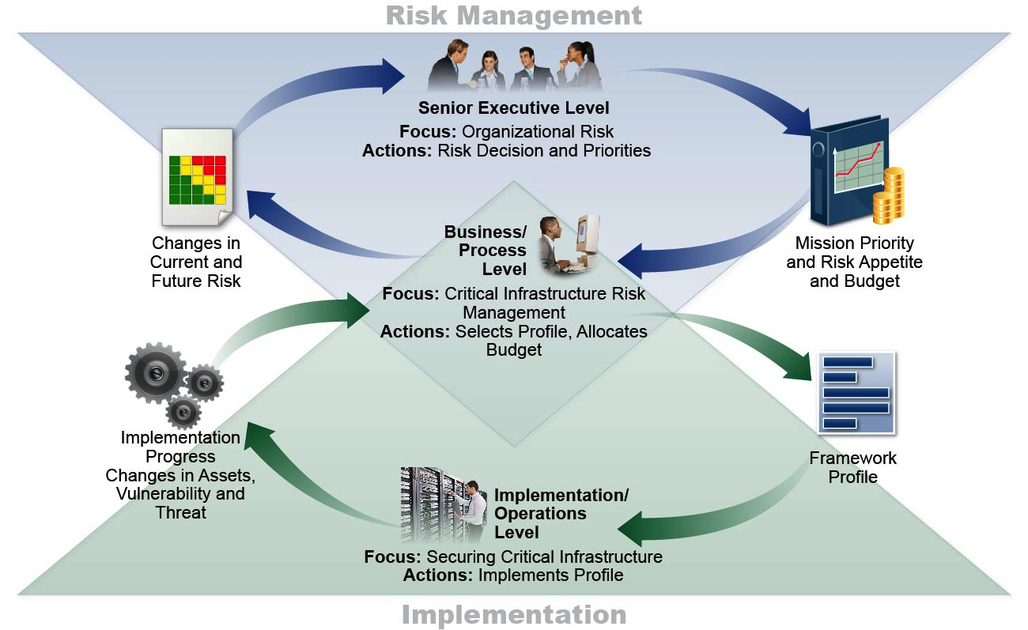
Supporting Risk Management with Framework

Slide 15
Framework 7-Step Process
Step 1: Prioritize and Scope
Step 2: Orient
Step 3: Create a Current Profile
Step 4: Conduct a Risk Assessment
Step 5: Create a Target Profile
Step 6: Determine, Analyze, and Prioritize Gaps
Step 7: Implementation Action Plan

Slide 16
Building a Profile A Profile Can be Created in Three Steps
1
Mission
Objective
A
B
C
Subcategory
1
2
3
…
98
Cybersecurity
Requirements
Legislation
Regulation
Internal & External Policy
Best Practice
Operating
Methodologies
Guidance and methodology on implementing,
managing, and
monitoring
2
3

Slide 17
Conceptual Profile Value Proposition
Cybersecurity Requirements | Subcategory | Priority | Operating Methodologies
A | 1 | moderate | I II
B C | 2 | high | III
D E | 3 | moderate | IV V
F | … | … | VI VII
G | 98 | moderate | VIII
2
1
3
When you organize yourself in this way:
Compliance reporting becomes a byproduct of running your security operation
Adding new security requirements is straightforward
Adding or changing operational methodology is non-intrusive to on-going operation

Slide 18
Resource and Budget Decision Making What Can You Do with a CSF Profile?
As-Is
Year 1
To-Be
Year 2
To-Be
Sub- category | Priority | Gaps | Budget | Year 1 Activities | Year 2 Activities
1 | moderate | small | $$$ |  | X
2 | high | large | $$ | X
3 | moderate | medium | $ | X
… | … | … | …
98 | moderate | none | $$ |  | reassess
…and supports on-going operational decisions, too

Slide 19
Profile Ecosystem
TAXONOMY
REQUIREMENTS
PRIORITIES
1
2
3
...
98
1 | Req A
2 | Req B
3 | Req C
... | ...
98 | Req ZZ
1 | Req A | High
2 | Req B | Mod
3 | Req C | Low
... | ... | ...
98 | Req ZZ | High
NIST
Organization or Community
Community
Cybersecurity Framework Core
Crosswalks
Mappings
Cybersecurity Framework Profile

Slide 20
Key Attributes
It’s a framework, not a prescriptive standard
Provides a common language and systematic methodology for managing cyber risk.
Is meant to be adapted.
Does not tell an organization how much cyber risk is tolerable, nor provide “the one and only” formula for cybersecurity.
Enable best practices to become standard practices for everyone via common lexicon to enable action across diverse stakeholders.
It’s voluntary
It’s a living document
It is intended to be updated as stakeholders learn from implementation, and as technology and risks change…more later.
That’s one reason why the Framework focuses on questions an organization needs to ask itself to manage its risk. While practices, technology, and standards will change over time—principles will not.

Slide 21
Common Patterns of Use
Integrate the functions into your leadership vocabulary and management tool sets.
Determine optimal risk management using Implementation Tiers.
Measure current risk management using Implementation Tiers.
Reflect on business environment, governance, and risk management strategy categories.
Develop a Profile of cybersecurity priorities, leveraging (Sub)Sector Profiles when available.

Slide 22
Work in Progress: Framework Roadmap
Authentication
Automated Indicator Sharing
Conformity Assessment
Cybersecurity Workforce
Data Analytics
Federal Agency Cybersecurity Alignment
International Aspects, Impacts, and Alignment
Supply Chain Risk Management
Technical Privacy Standards

Slide 23






Examples of Framework Industry Resources www.nist.gov/cyberframework/industry-resources
Italy’s National Framework for Cybersecurity
American Water Works Association’s Process Control System Security Guidance for the Water Sector
The Cybersecurity Framework
in Action: An Intel Use Case
Cybersecurity Risk Management and Best Practices Working Group 4: Final Report
Energy Sector Cybersecurity Framework Implementation Guidance

Slide 24





Examples of State & Local Use
Texas, Department of Information Resources
Aligned Agency Security Plans with Framework
Aligned Product and Service Vendor Requirements with Framework
North Dakota, Information Technology Department
Allocated Roles & Responsibilities using Framework
Adopted the Framework into their Security Operation Strategy
Houston, Greater Houston Partnership
Integrated Framework into their Cybersecurity Guide
Offer On-Line Framework Self-Assessment
National Association of State CIOs
2 out of 3 CIOs from the 2015 NASCIO Awards cited Framework as a part of their award-winning strategy
New Jersey
Developed a cybersecurity framework that aligns controls and procedures with Framework

Slide 25

NIST Baldrige Excellence Builders Baldrige Cybersecurity Excellence Builder
Manufacturing
Service
Small Business
Education
Healthcare
Non-profit
Cybersecurity (2017)
Self-assessment criteria with basis in Cybersecurity Framework
Complements NIST Baldrige Program’s performance excellence successes.
April 2-5, 2017 - 29th Annual Quest for Excellence Conference
Pre-conference workshop that focuses on cybersecurity will be held on April 2nd - visit: https://www.nist.gov/baldrige/qe

Slide 26

NIST Manufacturing Profile NIST Discrete Manufacturing Cybersecurity Framework Profile
Utilizing CSF Informative References to create tailored language for the manufacturing sector
NIST SP 800-53
NIST SP 800-82
ISA / IEC 62443
www.tiger-global.co.uk

Slide 27

USCG Maritime Bulk Liquids Transfer (BLT) Framework Profile
NCCoE and United States Coast Guard (USCG) worked together to draft a USCG Maritime Profile, based on the Cybersecurity Framework
Aligns the USCG’s cyber strategy with cybersecurity activities of the maritime bulk liquid transport operations of the oil & natural gas industry, utilizing standards and best practices guided by the Framework
The profile can help individual companies clarify how cybersecurity fits into their mission priorities and how best to allocate resources to secure their information and operational systems.
The profile is available at: https://www.uscg.mil/hq/cg5/cg544/docs/Maritime_BLT_CSF.pdf

Slide 28

Resources Where to Learn More and Stay Current
Framework for Improving Critical Infrastructure Cybersecurity and related news, information:
www.nist.gov/cyberframework
Additional cybersecurity resources: http://csrc.nist.gov/
Questions, comments, ideas: cyberframework@nist.gov

